Slide 1



Games market analysis
View in Power BI
Last data refresh:
8/10/2022 8:22:43 PM UTC
Downloaded at:
8/10/2022 8:26:36 PM UTC

Slide 2
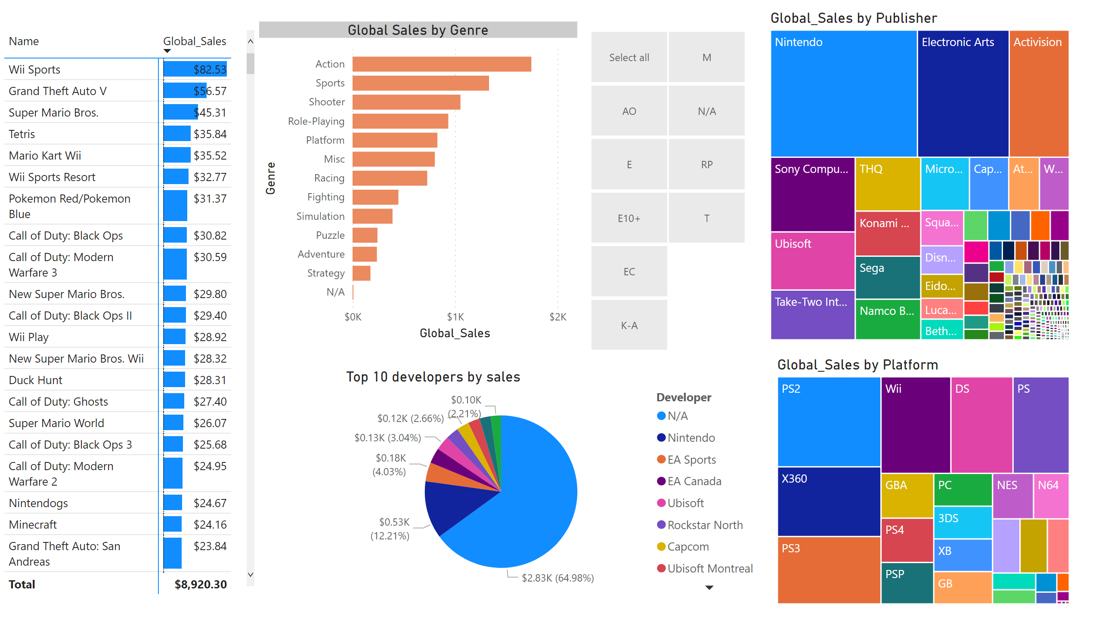
Visualization of sales
Notes:
treemap
No alt text provided
pivotTable
No alt text provided
slicer
No alt text provided
Global Sales by Genre
No alt text provided
Top 10 developers by sales
No alt text provided
treemap
No alt text provided

Slide 3
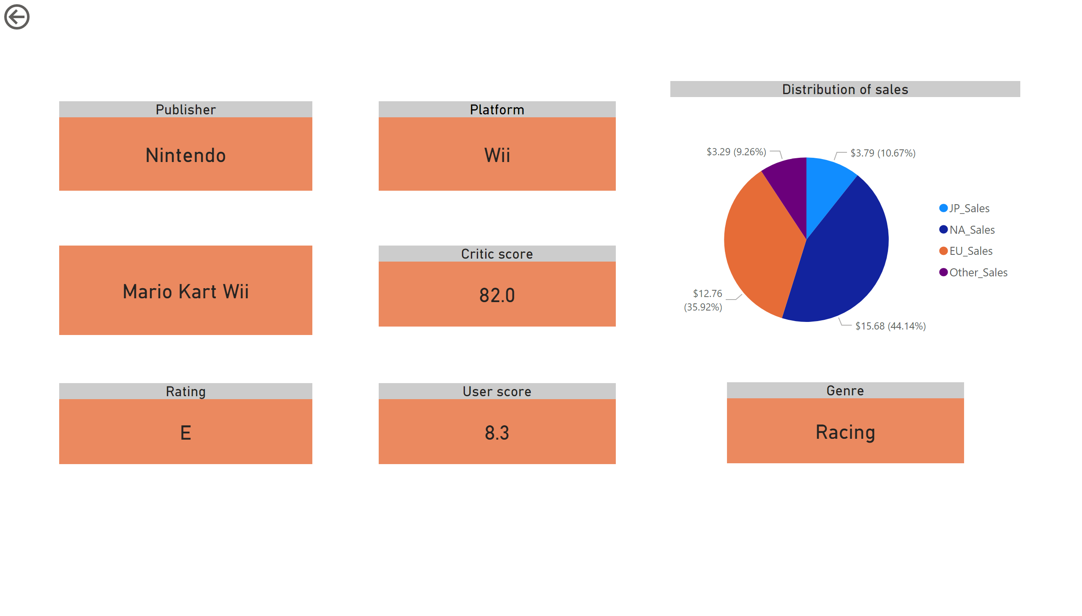
Product specifc details
Notes:
actionButton
No alt text provided
Distribution of sales
No alt text provided
card
No alt text provided
User score
No alt text provided
Platform
No alt text provided
Critic score
No alt text provided
Publisher
No alt text provided
Rating
No alt text provided
Genre
No alt text provided

Slide 4
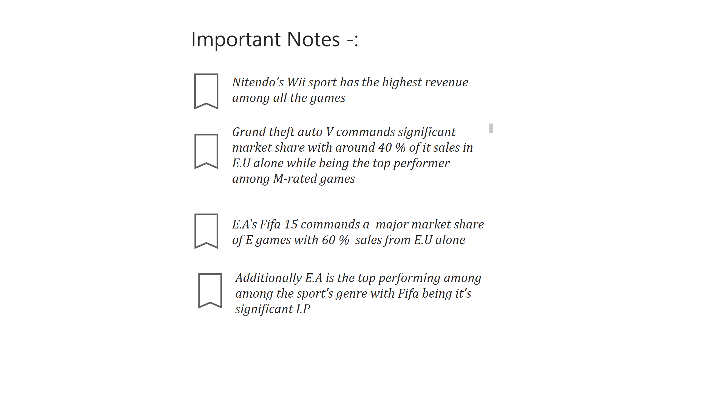
Bookmarks
Notes:
textbox
No alt text provided
actionButton
No alt text provided
textbox
No alt text provided
textbox
No alt text provided
actionButton
No alt text provided
actionButton
No alt text provided
textbox
No alt text provided
textbox
No alt text provided
actionButton
No alt text provided

